Slide 1
EagleSat 2: Structure
Erik Harang – Structures Team Lead
Embry-Riddle Aeronautical University Arizona Space Grant Consortium Symposium
April 17th, 2021

Slide 2
Outline
Project Overview
Overall Design
Design Philosophy
Finishes
Fabrication Plans & Additional Work
Contributions to Payload

Slide 3
Project Overview
Primary Goal
Create 3U CubeSat structure to support EagleSat 2’s payloads and bus systems.
Secondary Goals
Create a highly manufacturable structure.
Create a structure that’s easy to assemble and integrate.

Slide 4
Overall Design
Three 1U segments.
4 side rails.
4 brackets.
Top and bottom brackets with feet.
Rod and spacer board mounting system.
12 threaded rods.
Accommodate PC/104 standard boards.
Deployment Systems
2 bottom switches and 1 side switch.
2 bottom separation springs.
Anodization

Slide 5
Design Philosophy
Heavy emphasis on simplicity.
Get feedback from machinists to improve manufacturability.
Reduce the number of cutting operations required.
Be cautious with very thin sections.
Directly tap pieces instead of using helical inserts.
Move from Al6061 to Al7075.

Slide 6
Finishes
Anodization to reduce wear between CubeSat deployer and structure.
Required by Nanoracks.
Strongly recommended in the CubeSat standard.
Chemical conversion to increase conductivity throughout the structure.
Avoid charge differences between different parts of the structure.
Anodization
Chemical Conversion

Slide 7
Fabrication Plans & Additional Work
All the fabrication work will be done through Xometry.
Fewer suppliers leads to a more streamlined procurement process.
Structural simulations in Fusion 360.
Vibe-testing of integrated CubeSat.

Slide 8
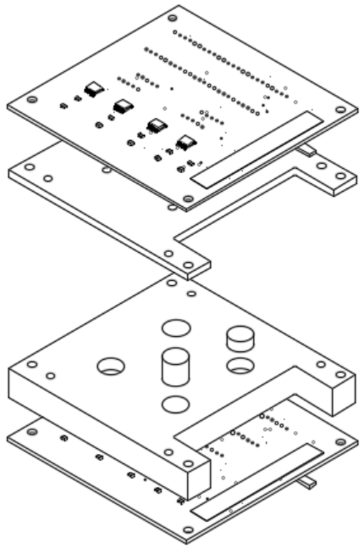
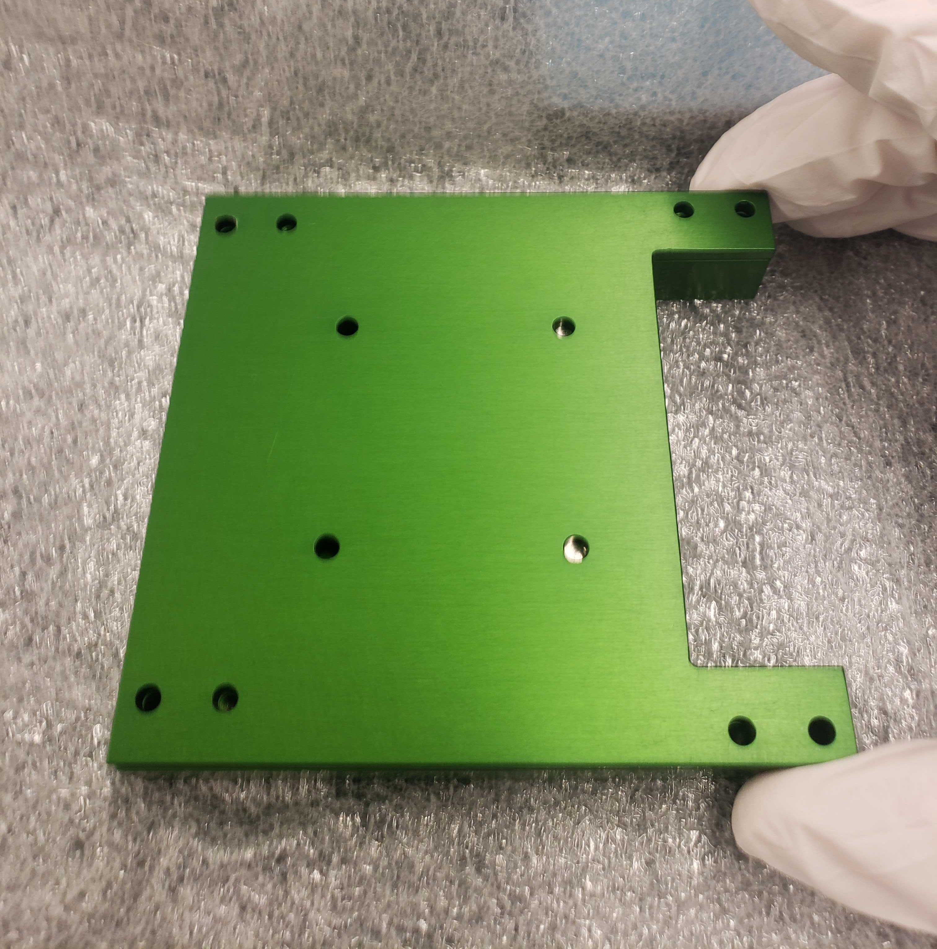
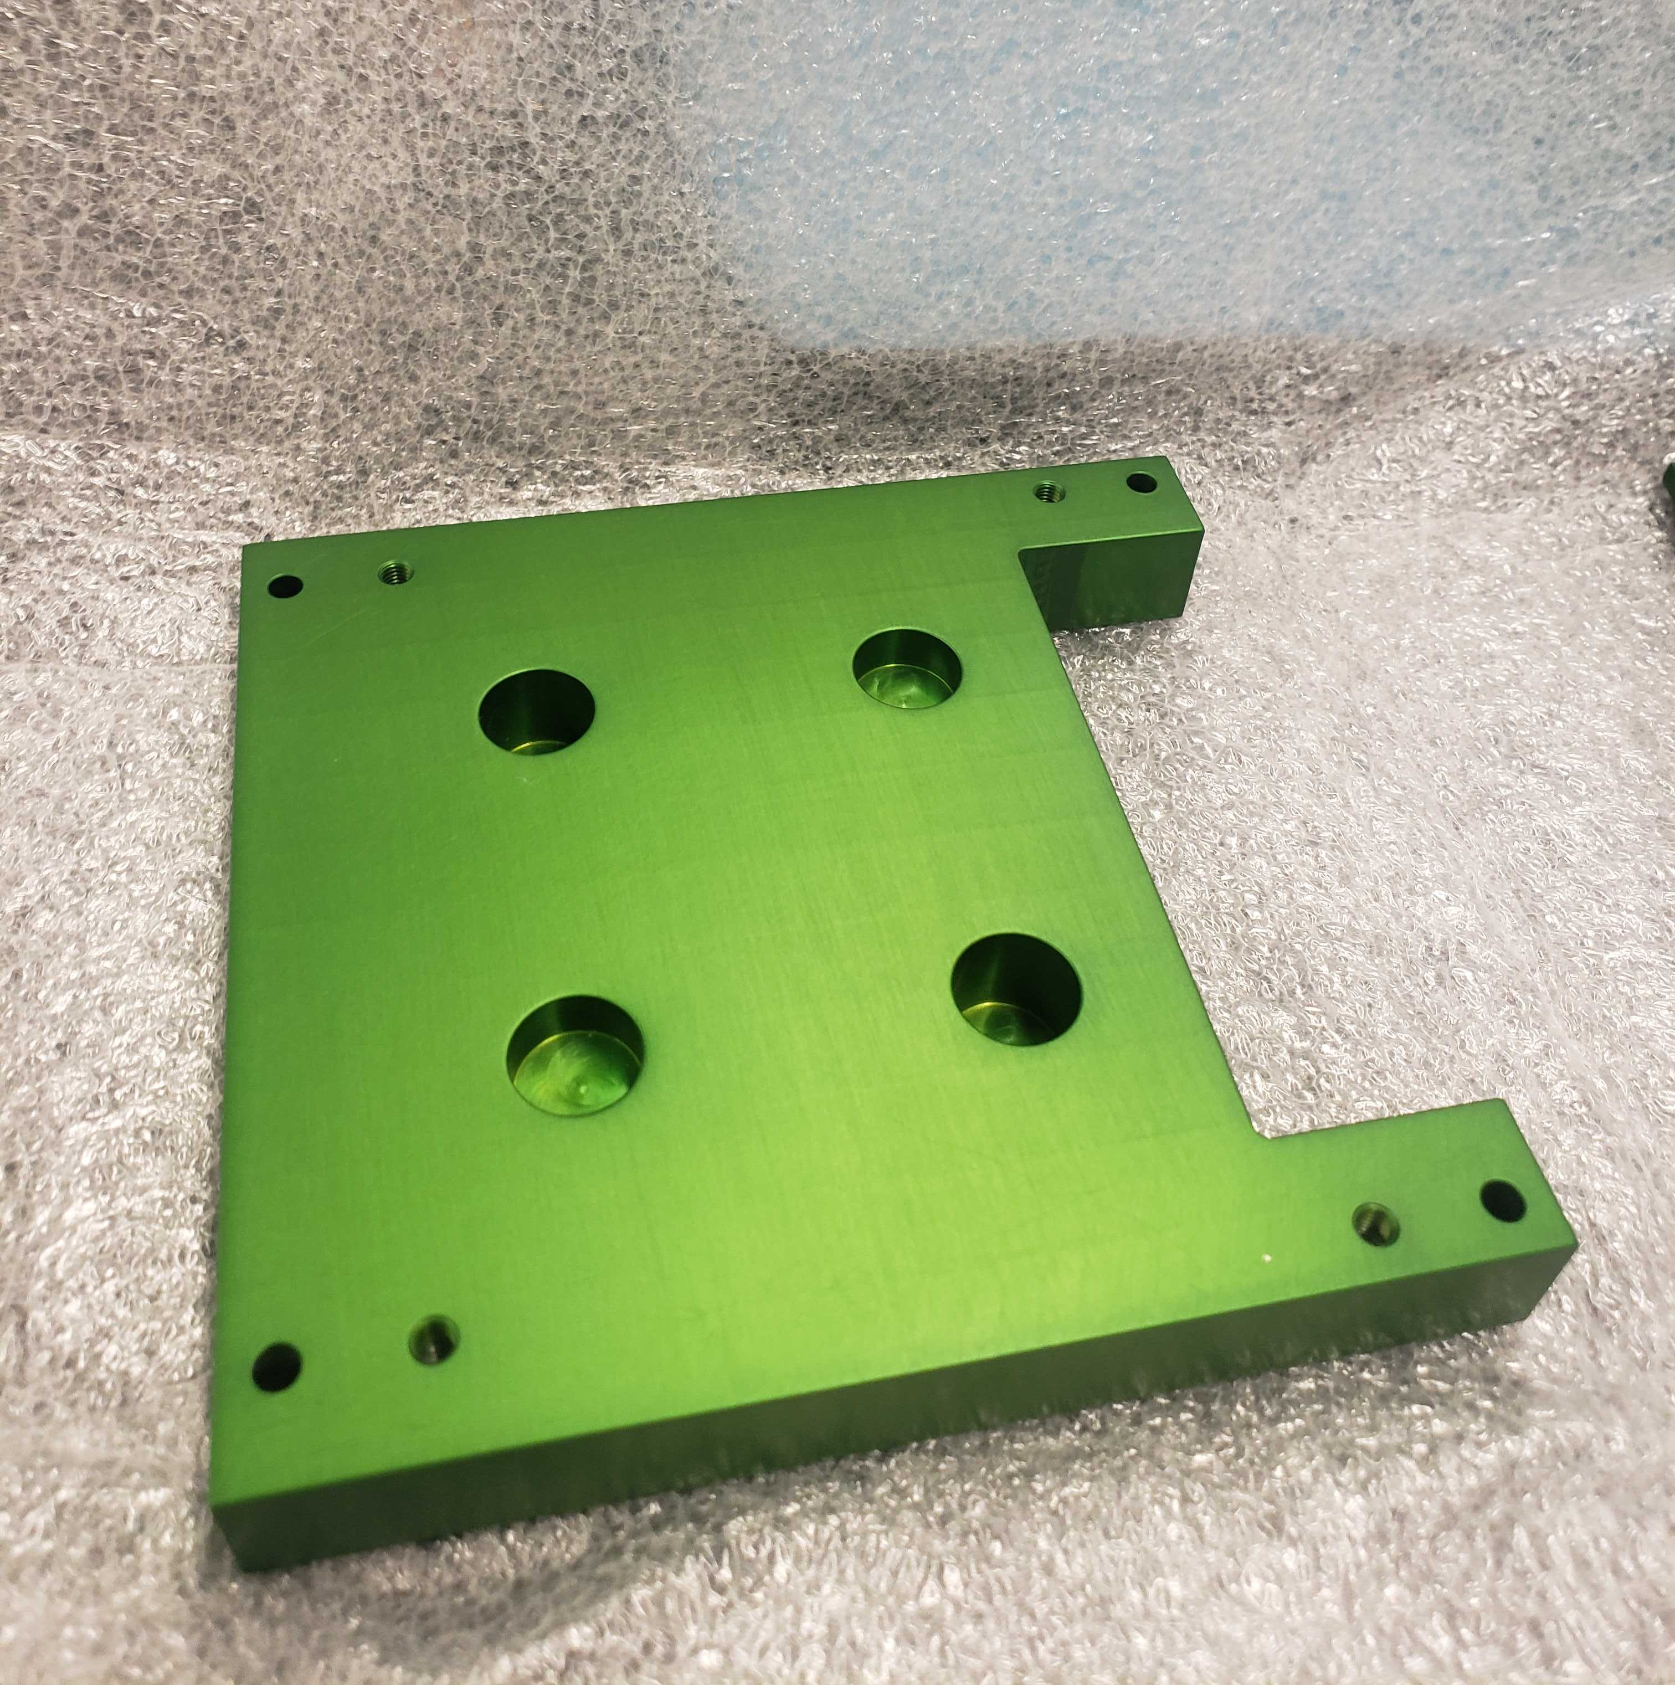
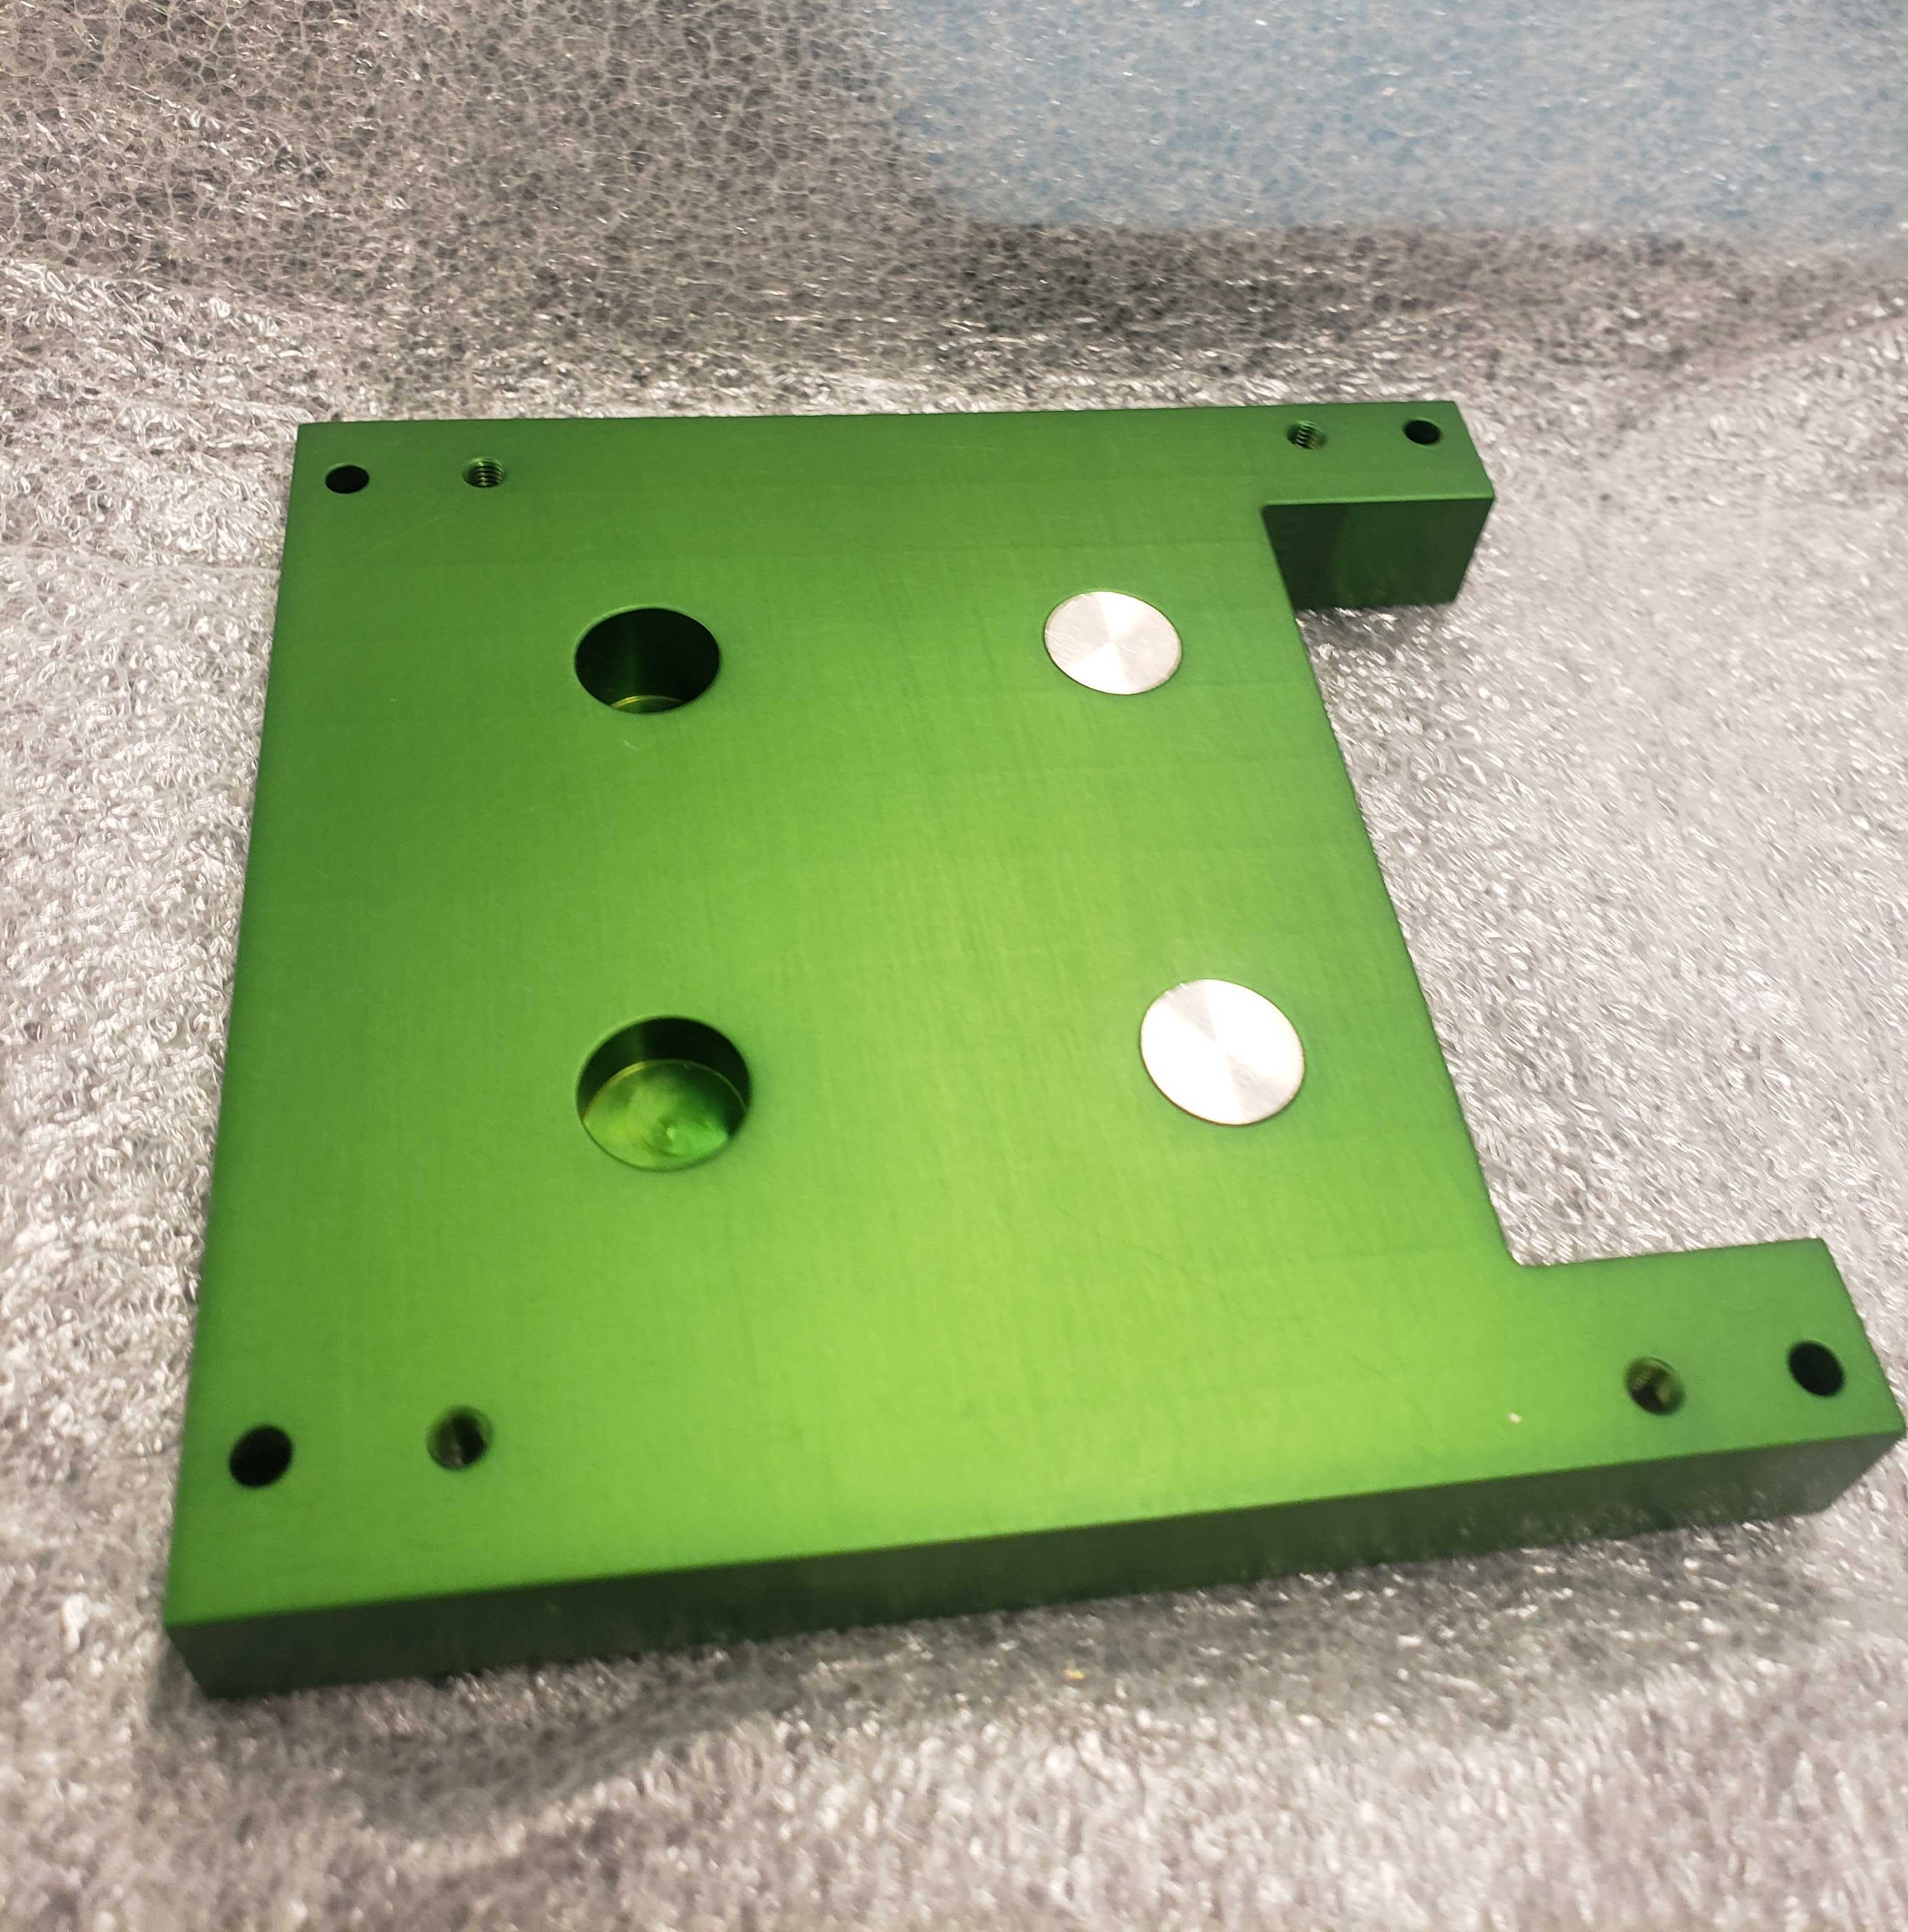
Contributions to Payload
PC/104 board-like brackets to hold platinum cylinders for EagleSat 2’s cosmic ray experiment.

Slide 9
Questions?

